Slide 1
HSOY50S1-2020US KATO NA 2020: Evaluation of SYN550023 efficacy against perennial SORHA in US
Holloway, James
Vaz Da Silva, Joao Renato, Eric Palmer
2020 Crop Protection Field Development
Last Updated: AUG-26-2020

Slide 2
Acknowledgements and Test Locations:
Trial | State | Cooperator/ Syngenta Rep | IH/ CRO/ COI | Target | Data was available for the summary presentation (Y/N) | Data was used to answer the protocol objective(s) (Y/N)
USNG0H0302020 | IL | Cully, Scott | IH | Mixed Seedling and Rhizome Johnsongrass | Y | Y
USSB0H0202020 | MS | Jackson, Ryan | IH | Rhizome Johnsongrass | Y | Y
USSD0H1102020 | LA | Moore, Scott | IH | Rhizome Johnsongrass | Y | Y
USSE0H4132020 | AR | Black, David | IH | Rhizome Johnsongrass | Y | Y
USSG0H0242020 | TN | Holloway, James | IH | Rhizome johnsongrass | Y | Y
USSJ0H2212020 | NC | Mascarenhas, Victor | IH | Rhizome johnsongrass | Y | Y

Slide 3
Objectives:
Does SYN550023 provide comparable efficacy on perennial SORHA to the standard clethodim?
Determine the lowest rate of SYN550023 that will provide acceptable control of perennial SORHA?
Determine if there are differences in efficacy or crop response among SYN550023 formulations?

Slide 4
Treatment
Trt No. | Trt Name | Product Description | Lot Code | Conc. | Type | Rate | Other Rate | Code | Method | Timing | Placement
1 | CHECK | CHECK
2 | AMSOL | AMMONIUM SULFATE |  |  | SL | 2.5 % v/v | 2.5 % V/V | A | NONINC | POSPOS | BROFOL
2 | EXF17381 [P] | SYN550023 (200) GA/L | SYN550023 | 200 gA/L | EC | 50 g a/ha | 0.25 L/ha | A | NONINC | POSPOS | BROFOL
2 | ADDITIVE AGRIDEX | ADDITIVE AGRIDEX |  |  | SL | 1 % v/v | 1 % V/V | A | NONINC | POSPOS | BROFOL
3 | AMSOL | AMMONIUM SULFATE |  |  | SL | 2.5 % v/v | 2.5 % V/V | A | NONINC | POSPOS | BROFOL
3 | EXF17381 [P] | SYN550023 (200) GA/L | SYN550023 | 200 gA/L | EC | 100 g a/ha | 0.5 L/ha | A | NONINC | POSPOS | BROFOL
3 | ADDITIVE AGRIDEX | ADDITIVE AGRIDEX |  |  | SL | 1 % v/v | 1 % V/V | A | NONINC | POSPOS | BROFOL
4 | AMSOL | AMMONIUM SULFATE |  |  | SL | 2.5 % v/v | 2.5 % V/V | A | NONINC | POSPOS | BROFOL
4 | EXF17381 [P] | SYN550023 (200) GA/L | SYN550023 | 200 gA/L | EC | 200 g a/ha | 1 L/ha | A | NONINC | POSPOS | BROFOL
4 | ADDITIVE AGRIDEX | ADDITIVE AGRIDEX |  |  | SL | 1 % v/v | 1 % V/V | A | NONINC | POSPOS | BROFOL
5 | AMSOL | AMMONIUM SULFATE |  |  | SL | 2.5 % v/v | 2.5 % V/V | A | NONINC | POSPOS | BROFOL
5 | EXF19214 [J] | SYN550023 (250) GA/L | SYN550023 | 250 gA/L | EC | 50 g a/ha | 0.2 L/ha | A | NONINC | POSPOS | BROFOL
5 | ADDITIVE AGRIDEX | ADDITIVE AGRIDEX |  |  | SL | 1 % v/v | 1 % V/V | A | NONINC | POSPOS | BROFOL
6 | AMSOL | AMMONIUM SULFATE |  |  | SL | 2.5 % v/v | 2.5 % V/V | A | NONINC | POSPOS | BROFOL
6 | EXF19214 [J] | SYN550023 (250) GA/L | SYN550023 | 250 gA/L | EC | 100 g a/ha | 0.4 L/ha | A | NONINC | POSPOS | BROFOL
6 | ADDITIVE AGRIDEX | ADDITIVE AGRIDEX |  |  | SL | 1 % v/v | 1 % V/V | A | NONINC | POSPOS | BROFOL
7 | AMSOL | AMMONIUM SULFATE |  |  | SL | 2.5 % v/v | 2.5 % V/V | A | NONINC | POSPOS | BROFOL
7 | EXF19214 [J] | SYN550023 (250) GA/L | SYN550023 | 250 gA/L | EC | 200 g a/ha | 0.8 L/ha | A | NONINC | POSPOS | BROFOL
7 | ADDITIVE AGRIDEX | ADDITIVE AGRIDEX |  |  | SL | 1 % v/v | 1 % V/V | A | NONINC | POSPOS | BROFOL

Slide 5
Treatment
Trt No. | Trt Name | Product Description | Lot Code | Conc. | Type | Rate | Other Rate | Code | Method | Timing | Placement
8 | AMSOL | AMMONIUM SULFATE |  |  | SL | 2.5 % v/v | 2.5 % V/V | A | NONINC | POSPOS | BROFOL
8 | EXF18546 [H] | SYN550023 (500) GA/L | SYN550023 | 500 gA/L | SC | 50 g a/ha | 0.1 L/ha | A | NONINC | POSPOS | BROFOL
8 | ADDITIVE AGRIDEX | ADDITIVE AGRIDEX |  |  | SL | 1 % v/v | 1 % V/V | A | NONINC | POSPOS | BROFOL
9 | AMSOL | AMMONIUM SULFATE |  |  | SL | 2.5 % v/v | 2.5 % V/V | A | NONINC | POSPOS | BROFOL
9 | EXF18546 [H] | SYN550023 (500) GA/L | SYN550023 | 500 gA/L | SC | 100 g a/ha | 0.2 L/ha | A | NONINC | POSPOS | BROFOL
9 | ADDITIVE AGRIDEX | ADDITIVE AGRIDEX |  |  | SL | 1 % v/v | 1 % V/V | A | NONINC | POSPOS | BROFOL
10 | AMSOL | AMMONIUM SULFATE |  |  | SL | 2.5 % v/v | 2.5 % V/V | A | NONINC | POSPOS | BROFOL
10 | EXF18546 [H] | SYN550023 (500) GA/L | SYN550023 | 500 gA/L | SC | 200 g a/ha | 0.4 L/ha | A | NONINC | POSPOS | BROFOL
10 | ADDITIVE AGRIDEX | ADDITIVE AGRIDEX |  |  | SL | 1 % v/v | 1 % V/V | A | NONINC | POSPOS | BROFOL
11 | AMSOL | AMMONIUM SULFATE |  |  | SL | 2.5 % v/v | 2.5 % V/V | A | NONINC | POSPOS | BROFOL
11 | SELECT MAX 0.97 EC | CLETHODIM (116.23) GA/L |  | 116.23 gA/L | EC | 100 g a/ha | 0.86 L/ha | A | NONINC | POSPOS | BROFOL
11 | ADDITIVE AGRIDEX | ADDITIVE AGRIDEX |  |  | SL | 1 % v/v | 1 % V/V | A | NONINC | POSPOS | BROFOL
12 | AMSOL | AMMONIUM SULFATE |  |  | SL | 2.5 % v/v | 2.5 % V/V | A | NONINC | POSPOS | BROFOL
12 | FUSILADE DX 2 EC | FLUAZIFOP-P-BUTYL (240) GA/L |  | 240 gA/L | EC | 280 g a/ha | 1.17 L/ha | A | NONINC | POSPOS | BROFOL
12 | ADDITIVE AGRIDEX | ADDITIVE AGRIDEX |  |  | SL | 1 % v/v | 1 % V/V | A | NONINC | POSPOS | BROFOL

Slide 6
Weed Size at application
Trial | Application_Date | Pest Rhizome Johnsongrass | Crop_Pest_Min_Stage | Crop_Pest_Max_Stage | Crop_Pest_Majority_Stage | Crop_Pest_Min_Height | Crop_Pest_Max_Height | Crop_Pest_Height_Unit
USNG0H0302020 | 23-Jun-2020 | Sorghum halepense | 23 | 24 | 23 | 0 | 18 | IN
USSB0H0202020 | 13-Jun-2020 | Sorghum halepense | 15 | 59 | 17 | 6 | 19 | IN
USSD0H1102020 | 19-May-2020 | Sorghum halepense | 12 | 24 | 22 | 6 | 20 | IN
USSE0H4132020 | 01-Jun-2020 | Sorghum halepense | 13 | 15 | 14 | 9 | 24 | IN
USSG0H0242020 | 30-Apr-2020 | Sorghum halepense | 15 | 18 | 16 | 10 | 16 | IN
USSJ0H2212020 | 04-May-2020 | Sorghum halepense | 14 | 16 | 15 | 10 | 15 | IN

Slide 7
Rhizome Johnsongrass Control (7 DAA)
All treatments had AMS 2.5% and COC 1%

Slide 8
Rhizome Johnsongrass Control (14 DAA)
All treatments had AMS 2.5% and COC 1%

Slide 9
Rhizome Johnsongrass Control (28 DAA)
All treatments had AMS 2.5% and COC 1%

Slide 10
Rhizome Johnsongrass Control (42 DAA)
All treatments had AMS 2.5% and COC 1%

Slide 11
Results: 7 DAA
Conditional formatting is based on: RED < 80, YELLOW < 90, GREEN => 90

Slide 12
Results: 14 DAA

Slide 13
Results: 28 DAA

Slide 14
Results: 42 DAA

Slide 15
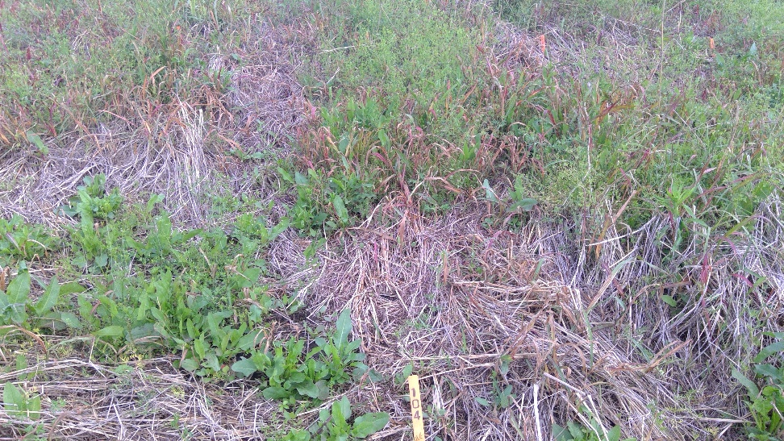
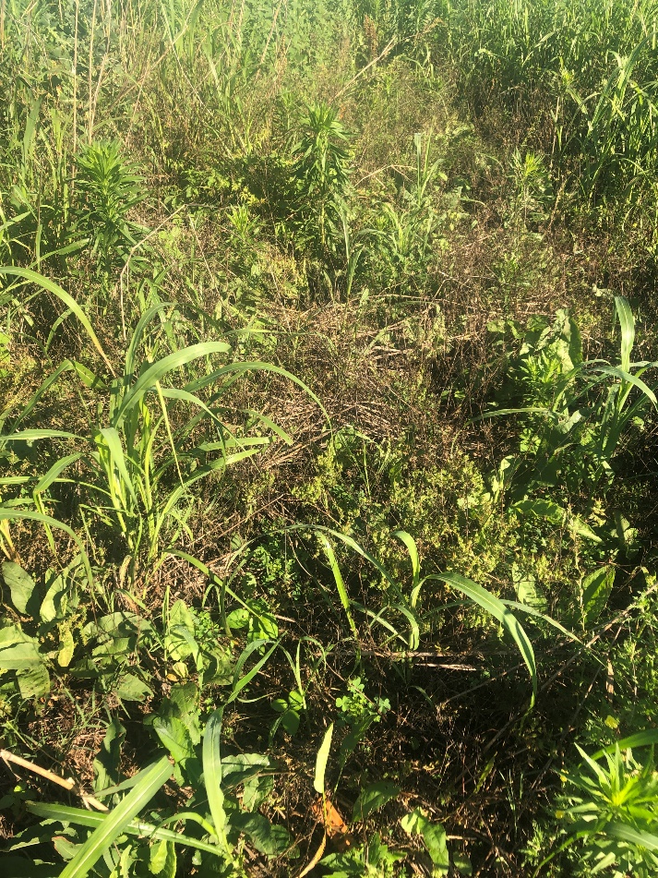
Trt 4: AMSOL 2.5 % v/v + SYN550023 (200 EC) GA/L 200 g a/ha + ADDITIVE AGRIDEX 1 % v/v - TN
14 DAT
42 DAT

Slide 16
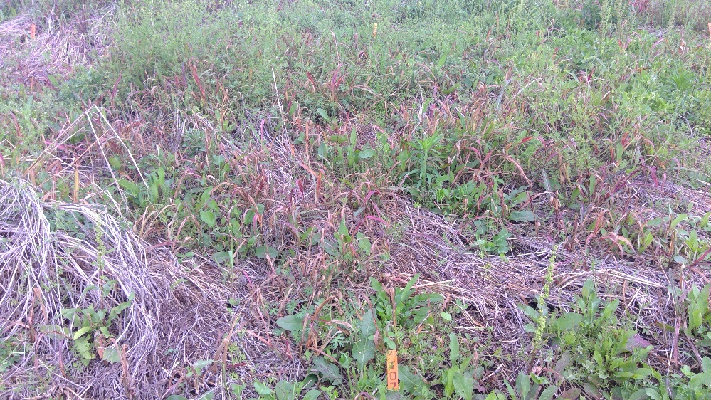
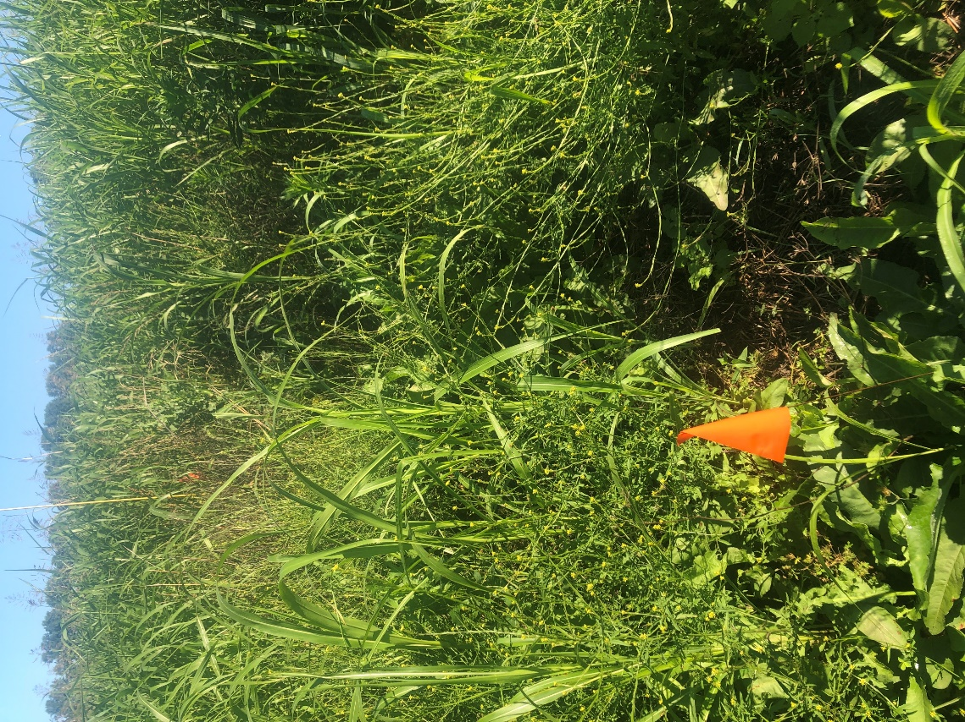
Trt 7: AMSOL 2.5 % v/v + SYN550023 (250 EC) GA/L 200 g a/ha + ADDITIVE AGRIDEX 1 % v/v - TN
14 DAT
42 DAT

Slide 17
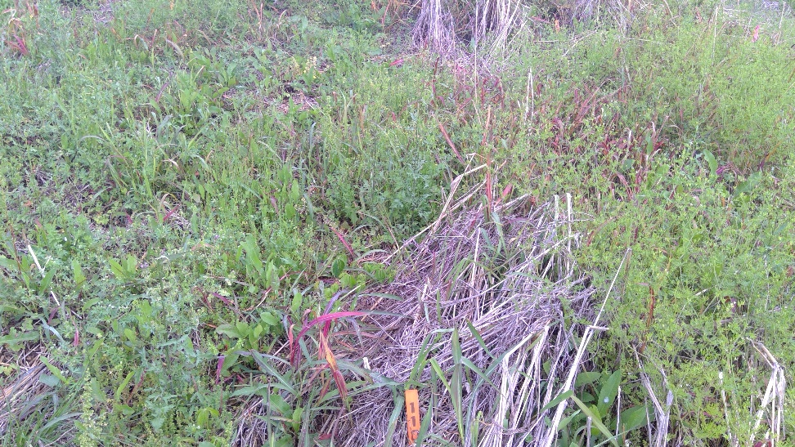
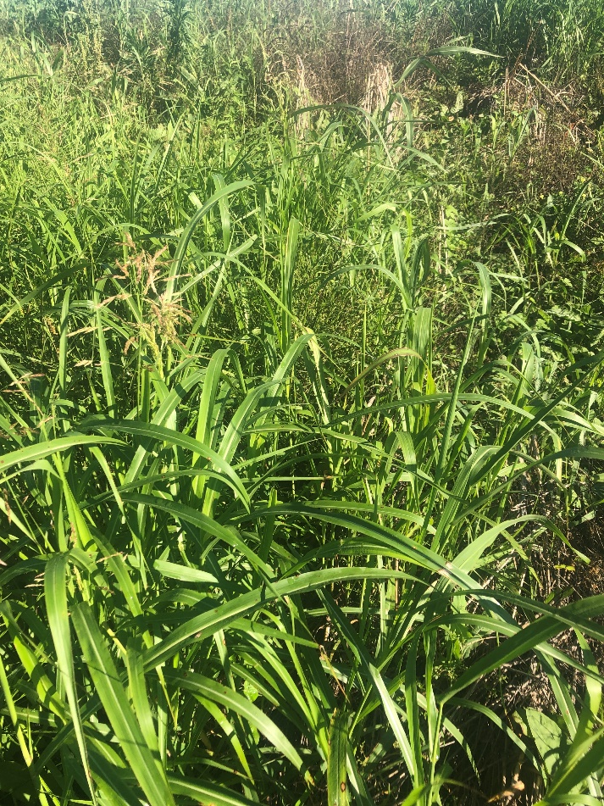
Trt 10: AMSOL 2.5 % v/v + SYN550023 (500 SC) GA/L 200 g a/ha + ADDITIVE AGRIDEX 1 % v/v - TN
14 DAT
42 DAT

Slide 18
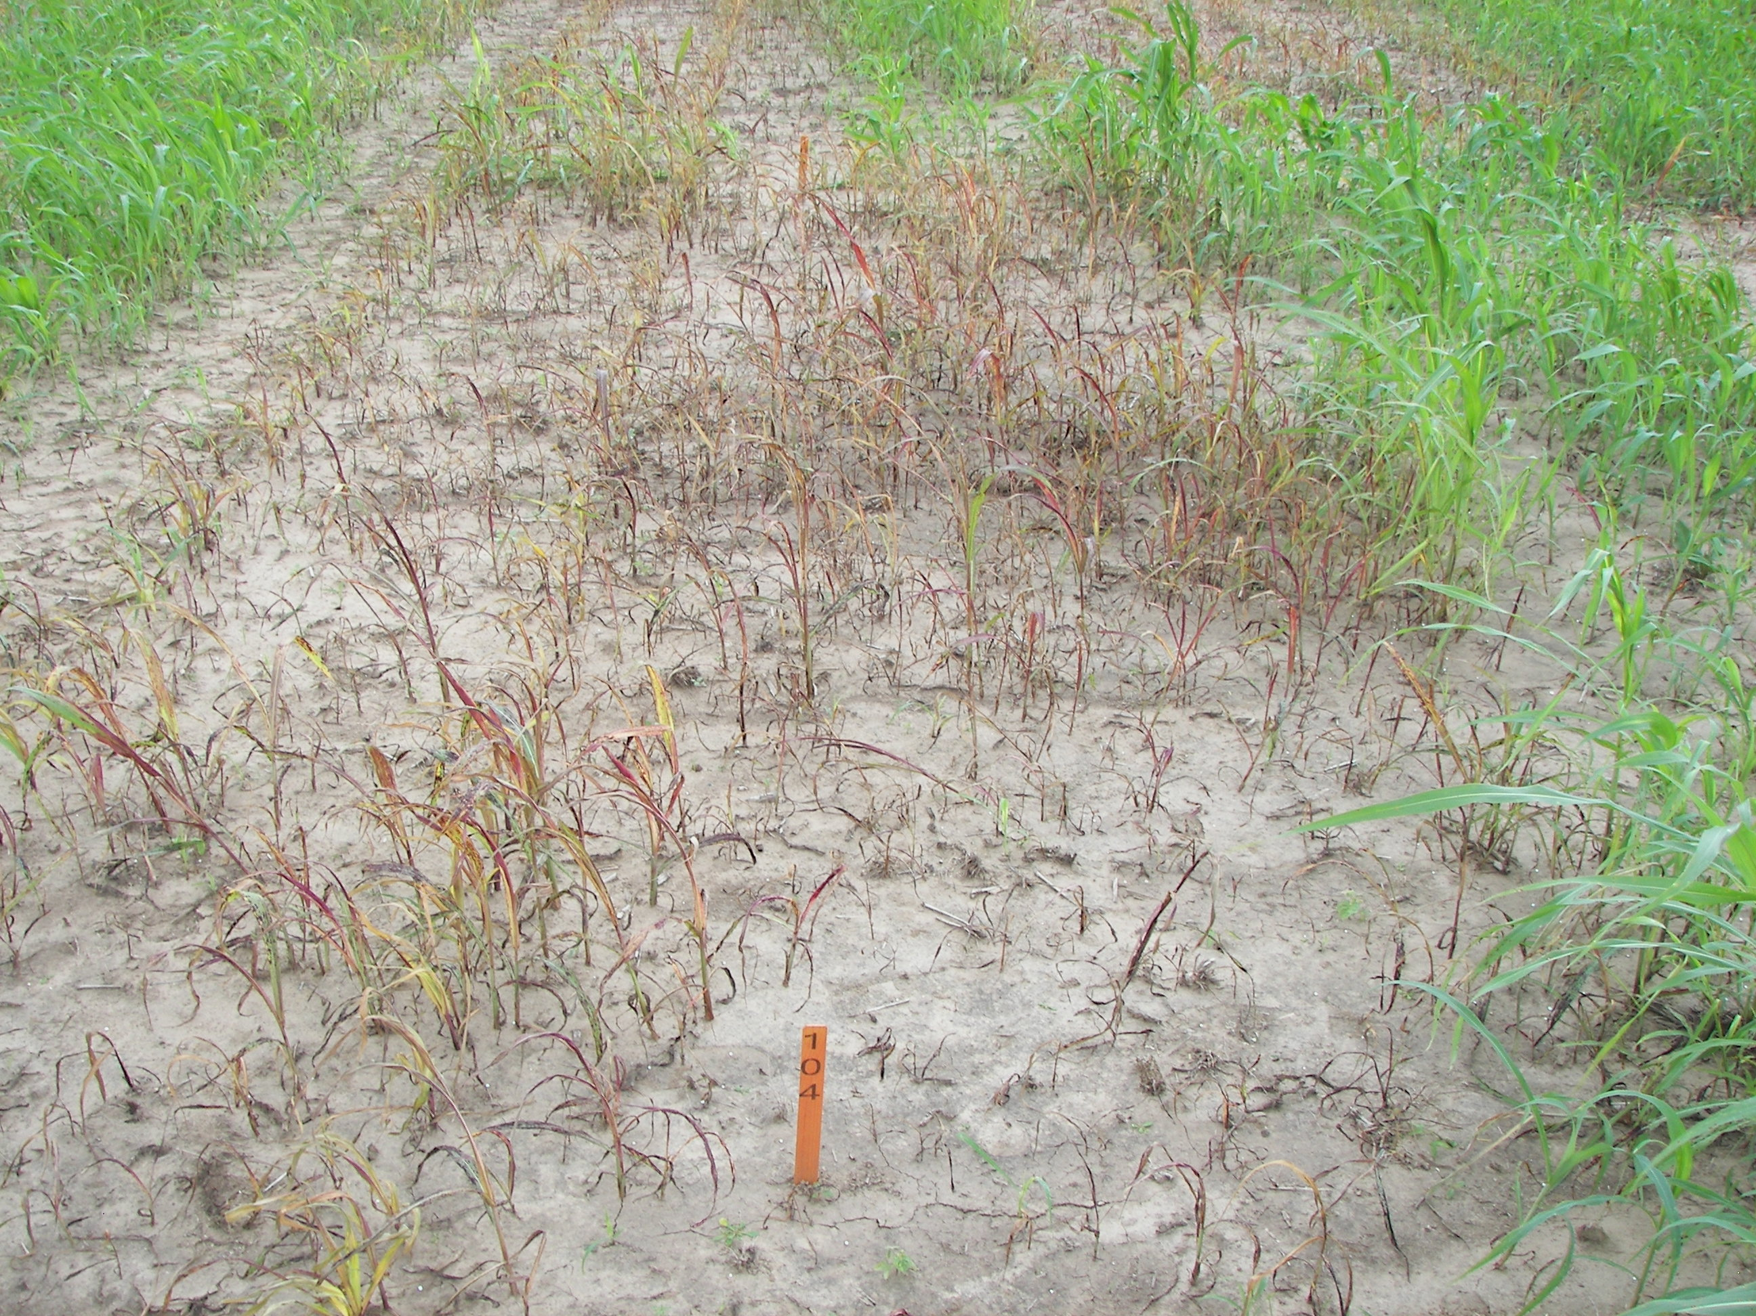
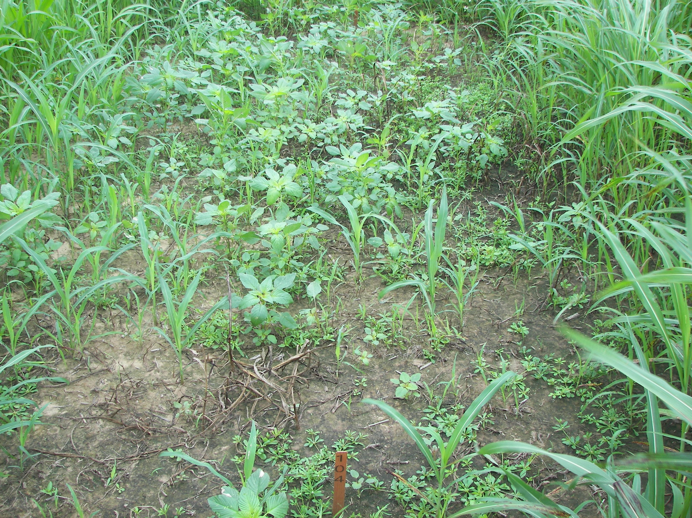
Trt 4: AMSOL 2.5 % v/v + SYN550023 (200 EC) GA/L 200 g a/ha + ADDITIVE AGRIDEX 1 % v/v - AR
7 DAT
21 DAT

Slide 19
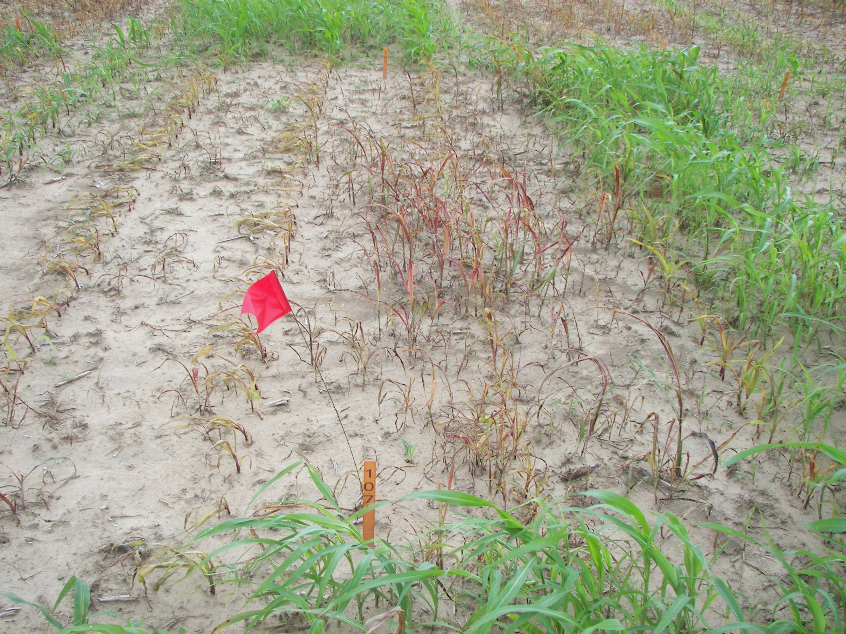
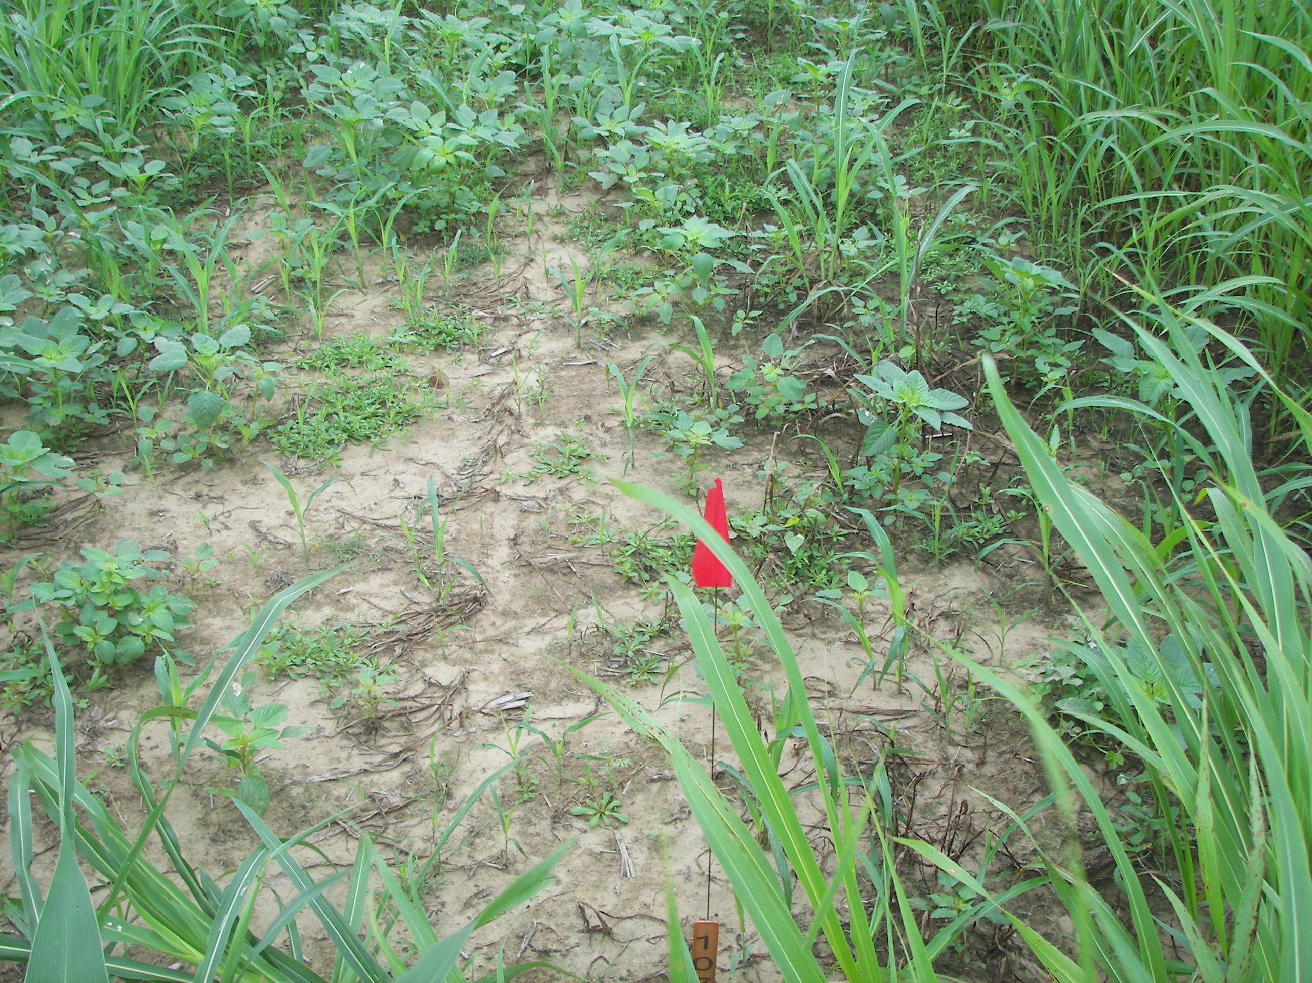
Trt 7: AMSOL 2.5 % v/v + SYN550023 (250 EC) GA/L 200 g a/ha + ADDITIVE AGRIDEX 1 % v/v - AR
7 DAT
21 DAT

Slide 20
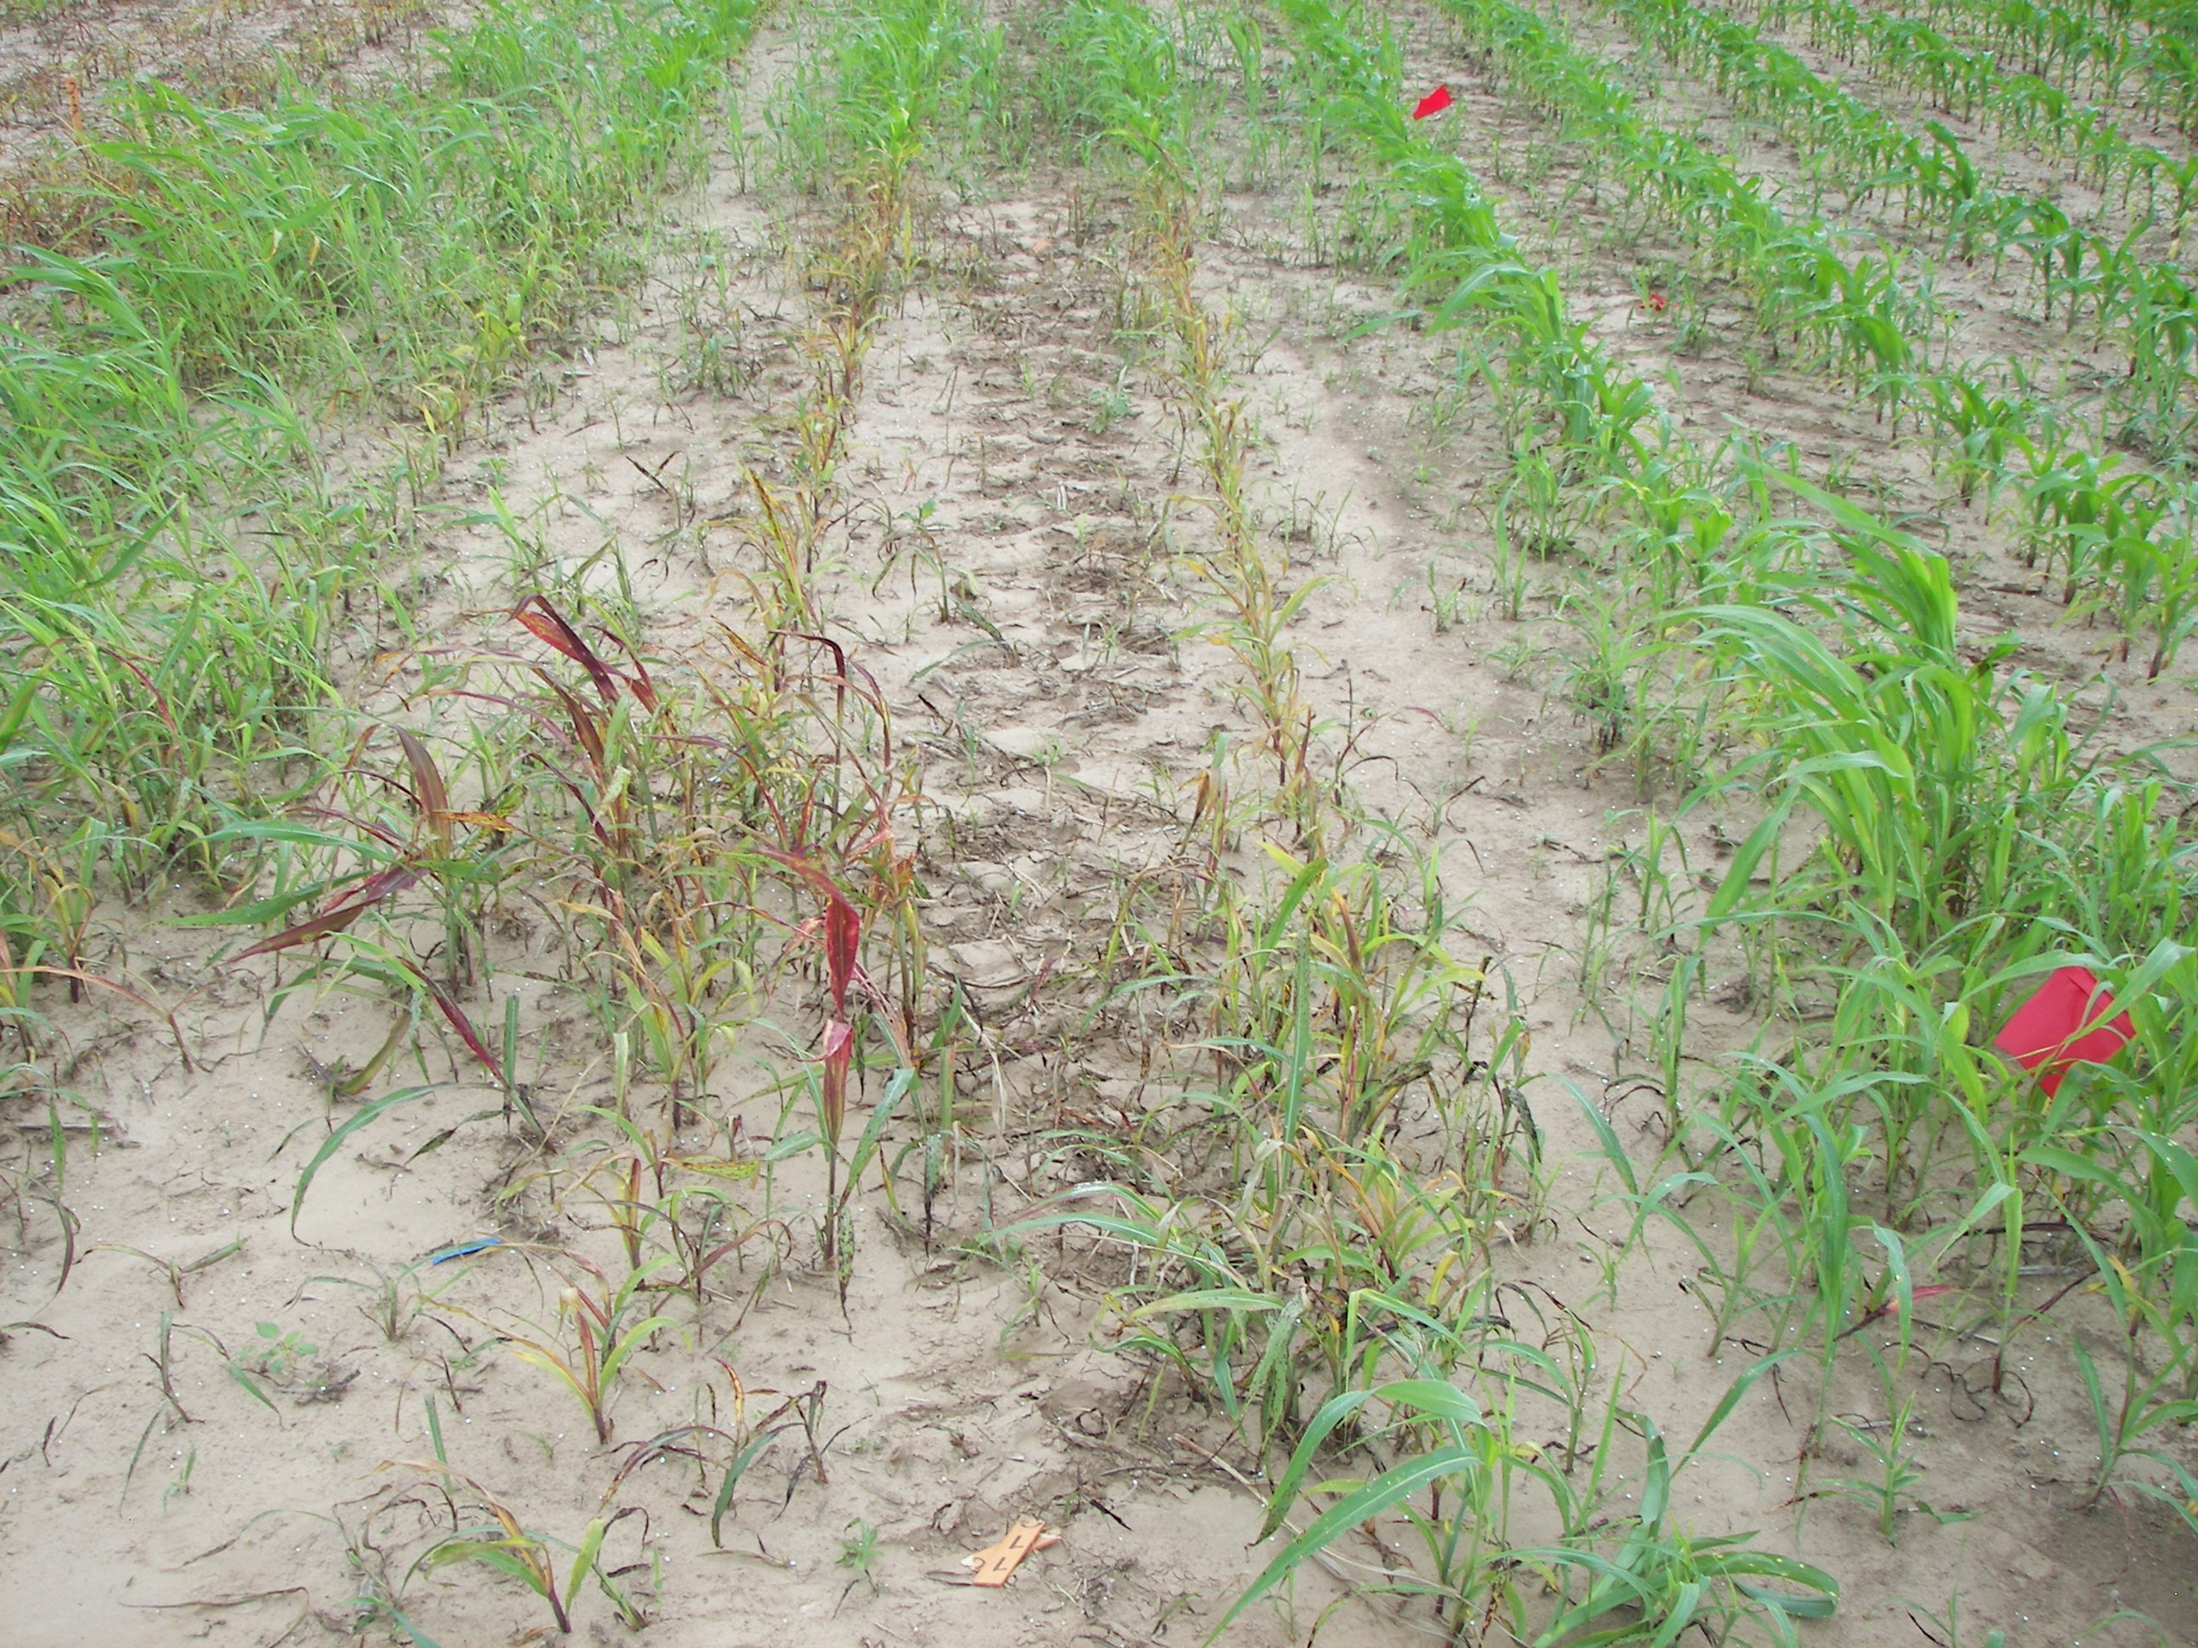
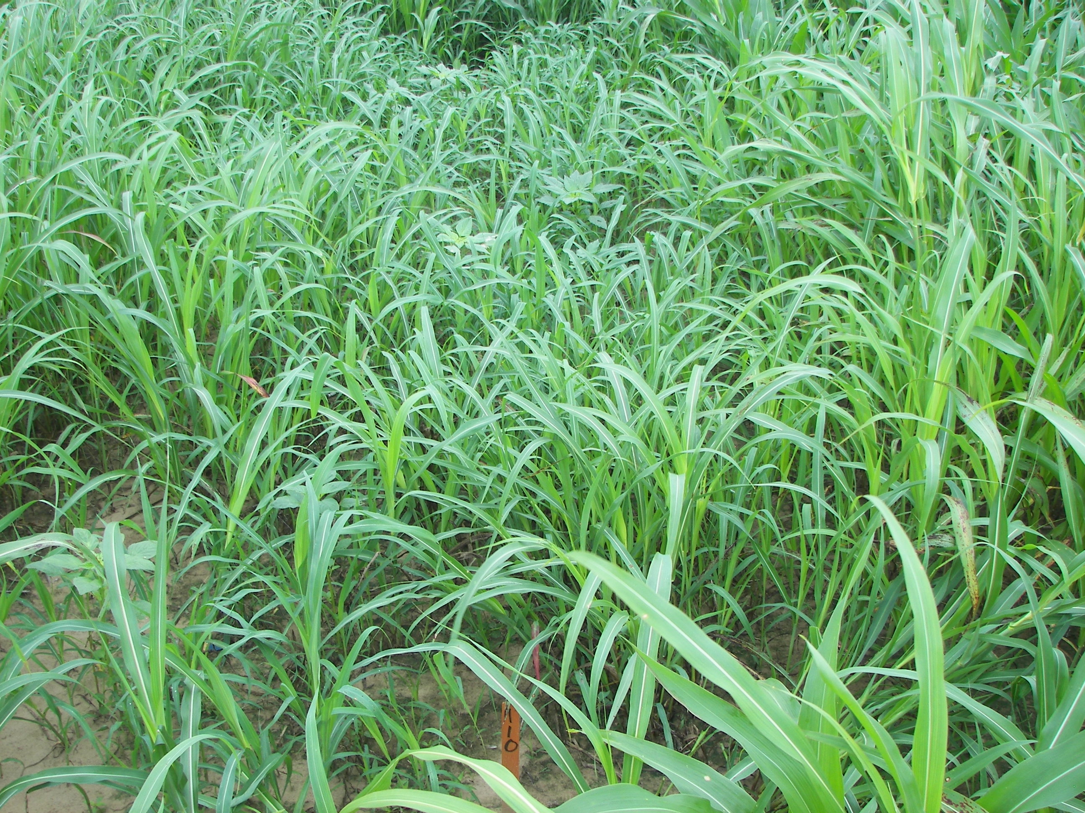
Trt 10: AMSOL 2.5 % v/v + SYN550023 (500 SC) GA/L 200 g a/ha + ADDITIVE AGRIDEX 1 % v/v - AR
7 DAT
21 DAT

Slide 21
Summary: Objectives answered & additional conclusions/observations
Does SYN550023 provide comparable efficacy on perennial SORHA to the standard clethodim?
Yes, the 200 and 250 EC at 200 g ai/ha provides comparable efficacy of SORHA when compared to clethodim; however, commercially acceptable control, (>90%), is not achieved.
Determine the lowest rate of SYN550023 that will provide acceptable control of perennial SORHA?
To achieve good control, >80% and <90%, 200 g of the 200 or the 250 EC must be used to accomplish this. No rate or formulation of SYN550023 provided commercially acceptable control, (90% or >) of perennial SORHA while Fusilade DX did provide 90% control, 42 DAA, on average.
Determine if there are differences in efficacy or crop response among SYN550023 formulations?
SORHA efficacy is good with SYN550023 with the 200 or 250 EC but the 500 SC does not provide similar control as the other formulations.

Slide 22
Recommendations:
If used as a SOLO product, evaluate SYN550023 200 or 250 EC at 200 g or higher plus other surfactants for control of Rhizome SORHA
Consider a tank mix of SYN550023 200 or 250 EC + Fusilade for control of Rhizome SORHA

